Slide 1

CMR COLLEGE OF ENGINEERING & TECHNOLOGY (UGC AUTONOMOUS) KANDLAKOYA, MEDCHAL ROAD, HYDERABAD – 501401 DEPARTMENT OF COMPUTER SCIENCE AND ENGINEERING
Project title | EXPENSE TRACKER
Name | Roll No | Batch No
1. G Vikas Reddy | 19H51A05N3 | B89
2. G Shashank Goud | 19H51A05N2 | B89
3. B Srinath | 19H51A05M8 | B89
Name of the Guide | Ms. A.Deepika

Slide 2
ABSTRACT
The name of our project is Expense Tracker. It is also called as money manager.
It is a software that helps to keep an accurate record of your money .
We are building this using react & java script. It is also voice powered by Speechly API .
It is done by state management in React, Context API , Local storage and Material UI .

Slide 3
INTRODUCTION
An Expense Tracker is a software or application that helps to keep an accurate record of your money inflow and outflow.
Inflow means Income. Outflow means Expense. There can be many ways of income and expense.
This expense tracker will manage everything related to money, that’s why its also called as money manager.
This can build some kind of discipline in usage of money. This reduces the chances of running out of money.

Slide 4
OBJECTIVE
Many people in India live on a fixed income, and they find that towards the end of the month they don’t have sufficient money to meet their needs.
While this problem can arise due to low salary, invariably it is due to poor money management skills..
Our objective is to build a expense tracker so that at the end of the month, you will have a clear view how you spend the money.
This is one of the best ways to get your expenses under control and bring some control on your finances.

Slide 5
EXISTING MODELS
Personal Capital
Mint
FreshBooks
QuickBooks

Slide 6
DRAWBACKS
Not free of cost.
Cannot use without internet.
Some have very complicated front end.
Didn’t have voice command
No proper security

Slide 7
PROPOSED METHOD
Our main aim is to prepare a voice powered expense tracker.
It should be controlled both by direct input as well as voice powered.
This should be done using speechly software.
It should be free of cost.
It should have simple graphical user interface so that user feel comfortable.

Slide 8
REQUIREMENTS
Node.js
React.js
Knowledge of front end
GitHub
VS Code
Speechly API

Slide 9
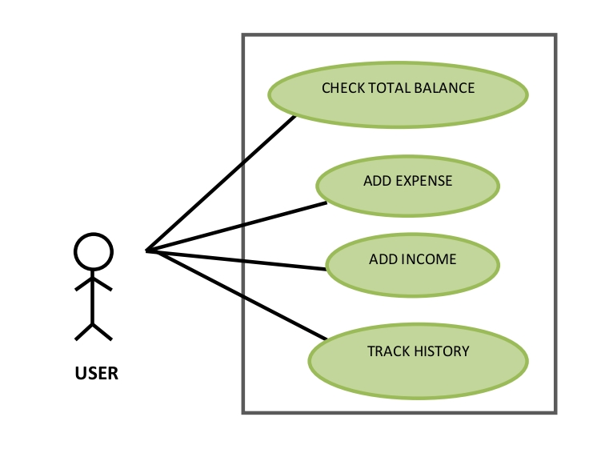
USE CASE DIAGRAM

Slide 10
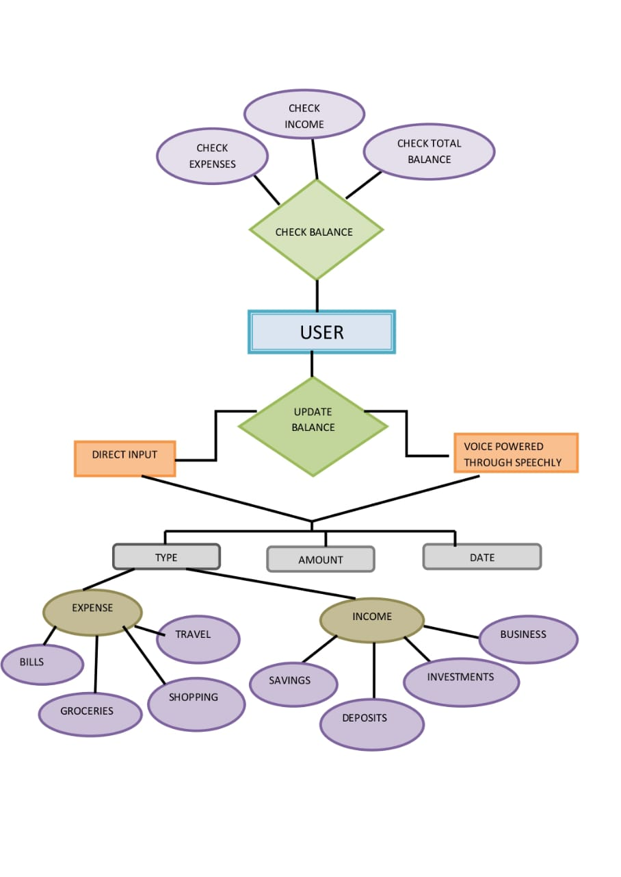
ER DIAGRAM

Slide 11
CONCLUSION:
Hence, we developed a voice based expense tracker.
It works both on direct text and voice command.
It has user friendly GUI.
User can check or update his balance in it.

Slide 12
FUTURE SCOPE
In future we can improve this software by connecting it to bank accounts.
We can further add different languages and different currencies to our application so that people can feel more comfortable to use it.
We can even add some warning if the user is going to become bankrupt.

Slide 13
REFERENCES
www.lifehack.org/articles/featured/an-introduction-to-expense-tracking.html?__cf_chl_tk=g26oPfP6xDsMExy9UFjbqod7ht0zofQsLYysxy.Lsfg-1637644598-0-gaNycGzNDWU
https://moneyview.in/beginners-guide-managing-money/what-is-an-expense-manager#:~:text=Also%20known%20as%20expense%20manager,money%20to%20meet%20their%20needs.
https://github.com/bradtraversy/expense-tracker-mern
https://github.com/bradtraversy/expense-tracker-react
https://www.cnbc.com/select/best-expense-tracker-apps/#:~:text=Best%20overall%20free%20app%3A%20Mint,small%20business%20owners%3A%20QuickBooks%20Online

Slide 14
THANK YOU

